Slide 1
Responsibility: Maps Tools: Photoshop, Easy Imagemap Generator
Creative Designer

Slide 2
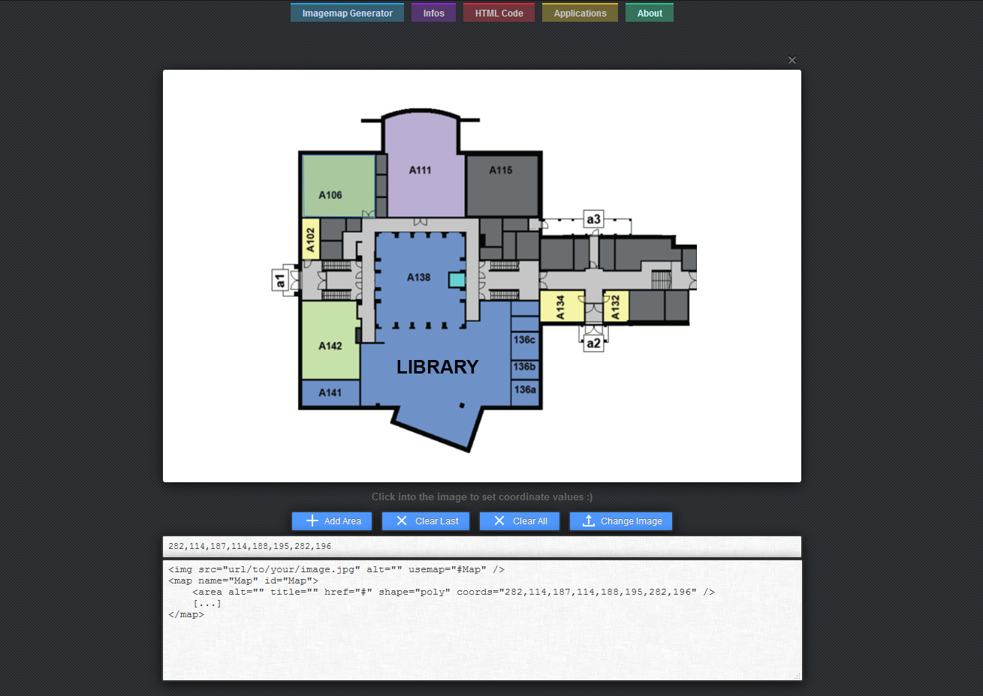
Easy Imagemap Generator

Slide 3
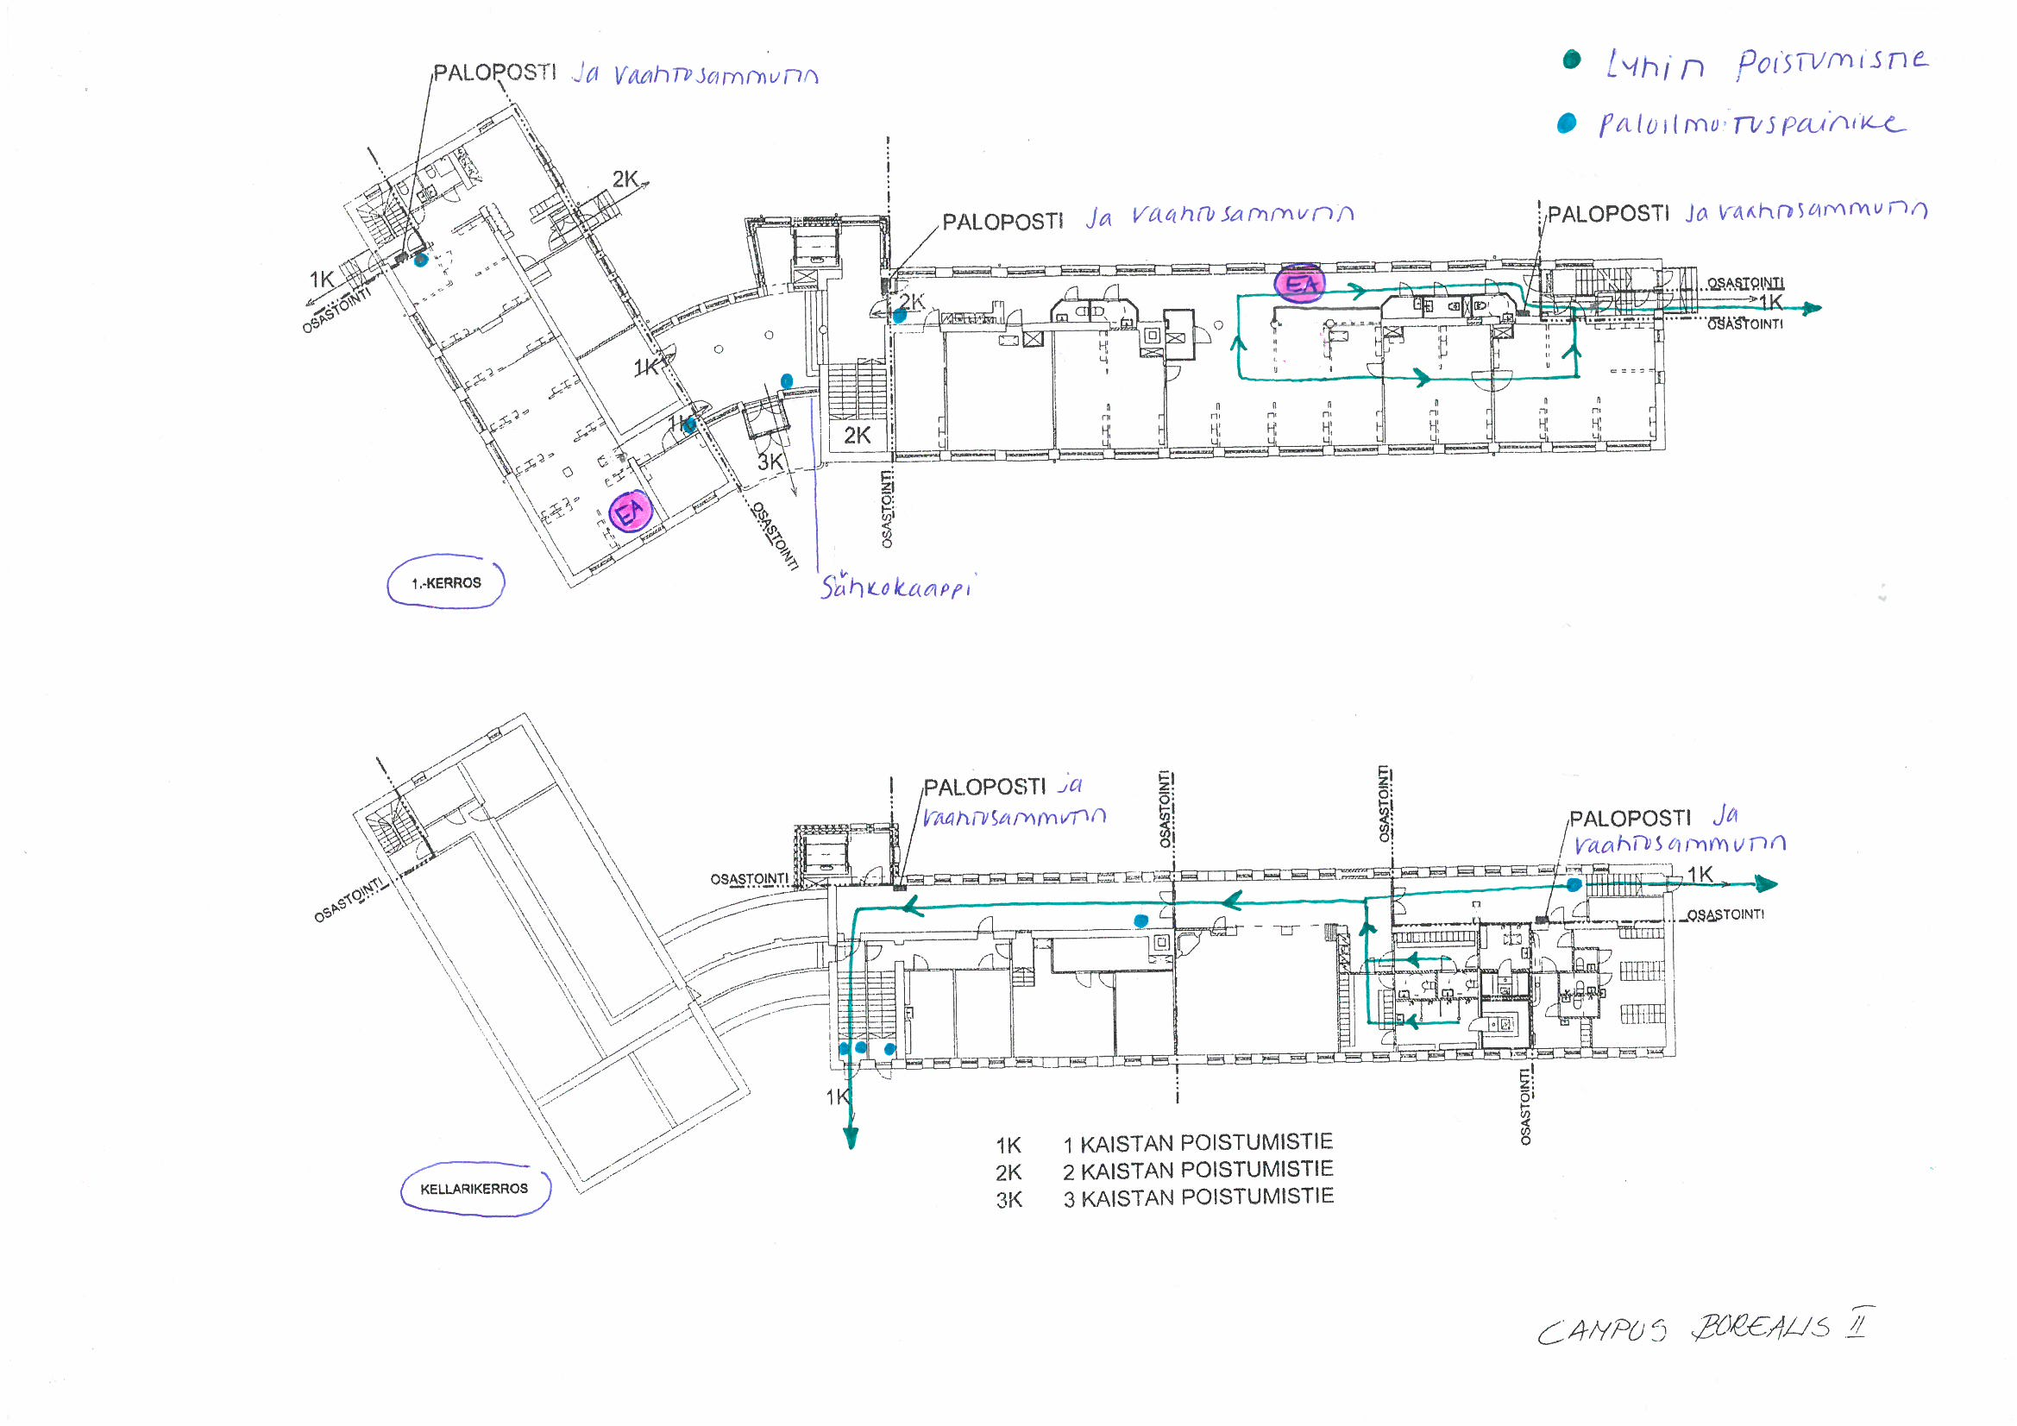
Before

Slide 4
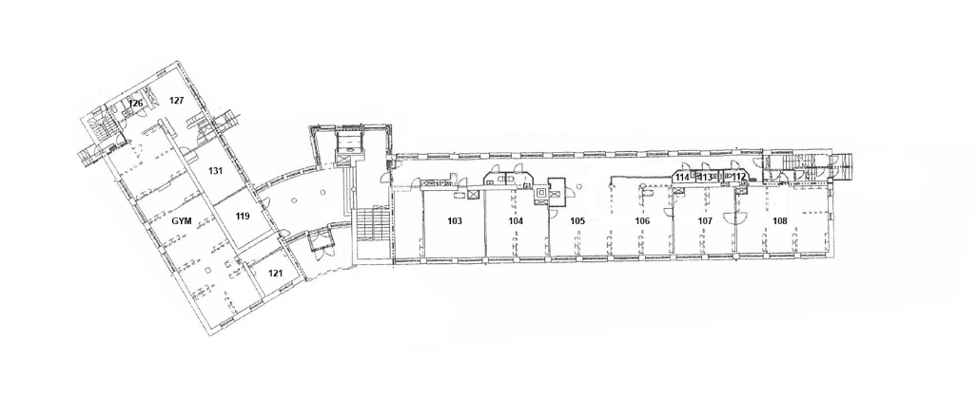
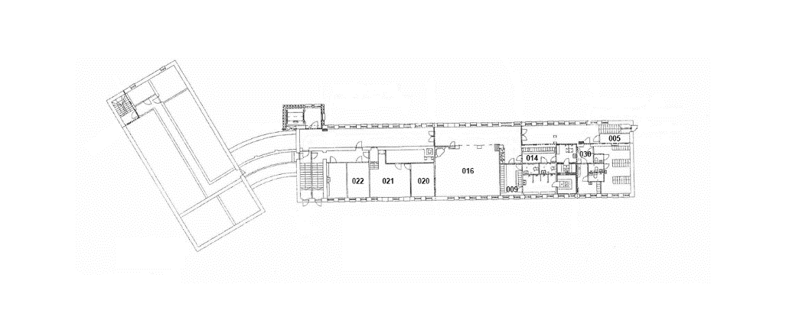
After

Slide 5
Better quality Design unification
Improvements

